Slide 1
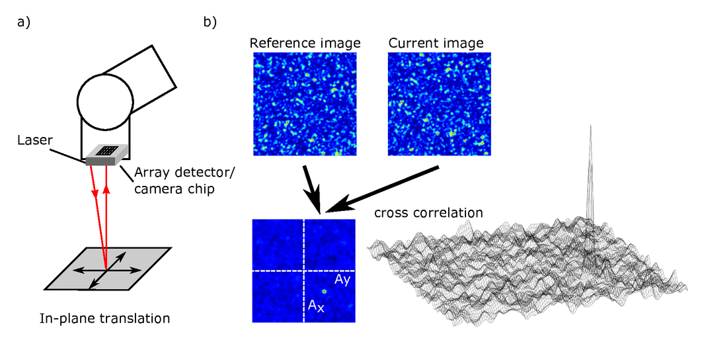
Laser Speckle Odometry for Robotic Applications

Slide 2
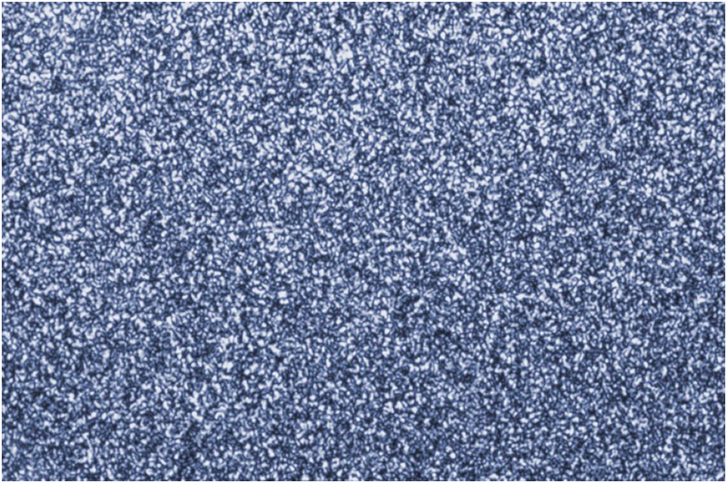
Laser Speckles
The term speckle refers to a random granular pattern which can be observed.
A laser speckle is formed when a highly coherent light source, i.e., a laser gets diffusely reflected of a rough surface.

Slide 3
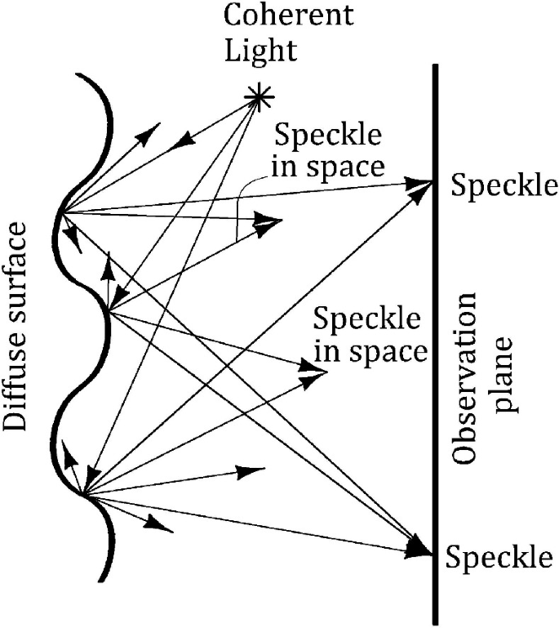
Formation of Speckles
Speckles form due to constructive and destructive interference within the laser beam at different points in space.

Slide 4
Laser Speckle Odometry
LASER Speckle Odometry is the method of measuring change in position of a body over time with help of laser speckle.

Slide 5
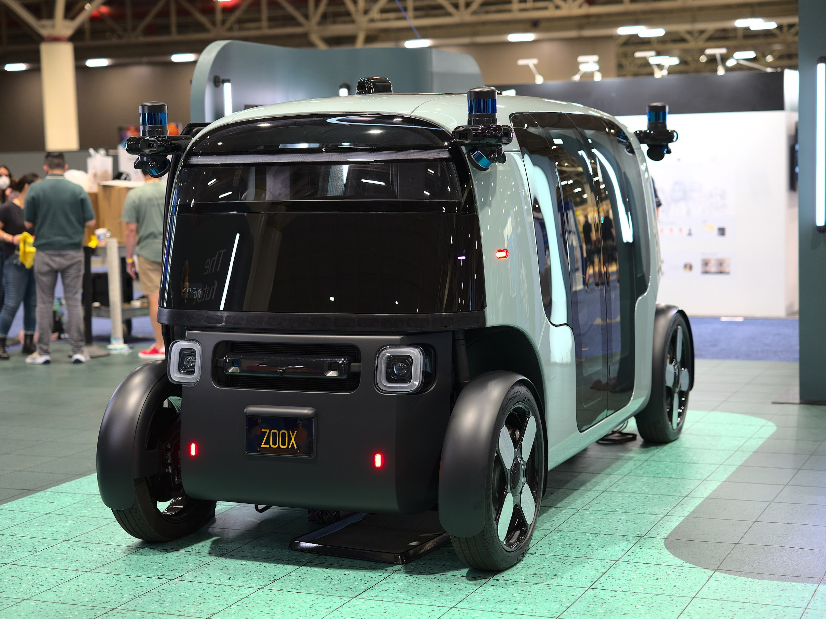
Autonomous Vehicles

Slide 6
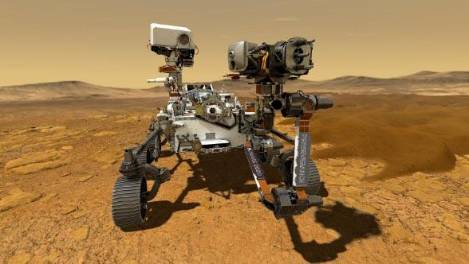
Space Rovers

Slide 7
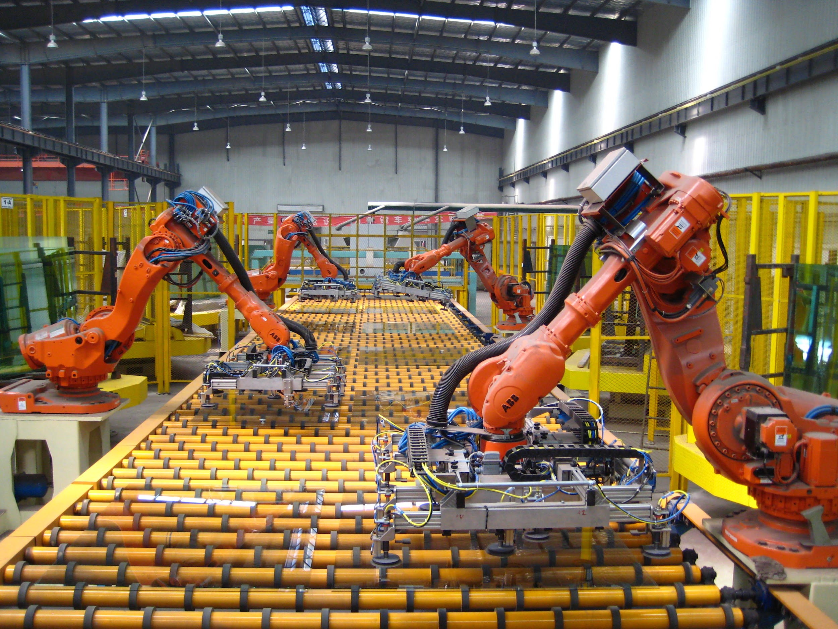
Industrial Robots

Slide 8
Advantages
Non-contact method- no errors due to conditions like wheel slip
Cheaper than cnc alternatives
Mechanical errors don’t creep into the measurements

Slide 9
Cross-Correlation
Cross Correlation is a measure of similarity of two series as a function of the displacement of one relative to the other.
Video for better understanding of cross correlation.

Slide 10
Process
Generate a speckle
Track changes in speckle pattern with cross-correlation
Determining the velocity and position of the body with respect to changes observed in the pattern
Use this feedback as input to a control system that would give required actuation to control the system

Slide 11
My Idea
The plan is to make a laser speckle odometer for spider-bot in robotics club and to incorporate it into the bots decision making control system.
A very close project has been mentioned in the first two research papers linked in the research paper section.

Slide 12
Research Papers
Walking Robots
Laser Odometry Taking Account of the Tilt on the Laser Sensor
Localization of a Walking Robot Using a Laser Speckle Odometry
Space Rovers
Noncontact Position Estimation Device with Optical Sensor and Laser Sources for Mobile Robots Traversing Slippery Terrains
Industrial Robotics
A non-contact laser speckle sensor for the measurement of robotic tool speed

Slide 13
State of Research
By far, this idea has only been implemented in experimental environment.
All these implementations were to test this ideas capability as an odometric system.
It was only used as a mere observation tool but was not used as deciding factor in any control system.

